Slide 1
YouTube Songs Analysis
Presented by : Alim Kamruddin Chogle
Data Analyst Intern
Batch No : MIP-DA-10

Slide 2
Introduction
YouTube is a massive platform for music, where videos can quickly gain popularity or go unnoticed. This project uses Power BI to dive deep into YouTube song data, aiming to discover what makes songs popular and how creators can improve their videos. This project aims to analyze YouTube song data using Power BI to uncover insights into video performance, engagement metrics, and audience preferences. By doing so, it seeks to provide actionable recommendations to optimize content strategy and enhance viewer engagement on the platform.

Slide 3
Objectives
Data Cleanup and Exploration: We start by cleaning up the data to ensure it’s accurate and ready for analysis. We’ll explore metrics like views, likes, and comments to understand how these numbers impact a video’s success.
Analyzing Channels and Content: We’ll look at which channels are most popular for music and how different types of content perform. By examining tags and descriptions, we’ll see what elements help videos get more views and engagement.
Finding Trends Over Time: We’ll track how video metrics change over time, figuring out when it’s best to release new content for maximum impact. This helps us understand seasonal trends and audience behavior patterns.
Understanding Viewer Engagement: We’ll explore how likes, comments, and shares affect the number of views a video gets. By understanding what engages viewers, we can suggest strategies for creators to improve their videos.

Slide 4
Problem Statement
This internship project aims to conduct a comprehensive analysis of YouTube songs data using Power BI. The dataset contains key attributes such as video ID, channel title, title, description, tags, published date, view count, like count, favorite count, comment count, video duration, video definition, and caption details. The goal is to utilize Power BI to create insightful visualizations and reports that provide a deeper understanding of YouTube songs' performance, popularity, and user engagement. The analysis aims to uncover trends, preferences, and patterns in the data to aid content creators and stakeholders in optimizing their YouTube song content.

Slide 5
Data Description
1. video_id: Unique identifier for each YouTube video.
2. channelTitle: Title of the YouTube channel publishing the song.
3. title: Title of the YouTube song video.
4. description: Description provided for the YouTube song video.
5. tags: Tags associated with the YouTube song video.
6. publishedAt: Date and time when the YouTube song video was published.
7. viewCount: Number of views received by the YouTube song video.
8. likeCount: Number of likes received by the YouTube song video.
9. favoriteCount: Number of times the YouTube song video has been marked as a favorite.
10. commentCount: Number of comments posted on the YouTube song video.
11. duration: Duration of the YouTube song video.
12. definition: Video definition or quality (e.g., HD, SD).
13. caption: Availability of captions for the YouTube song video.

Slide 6
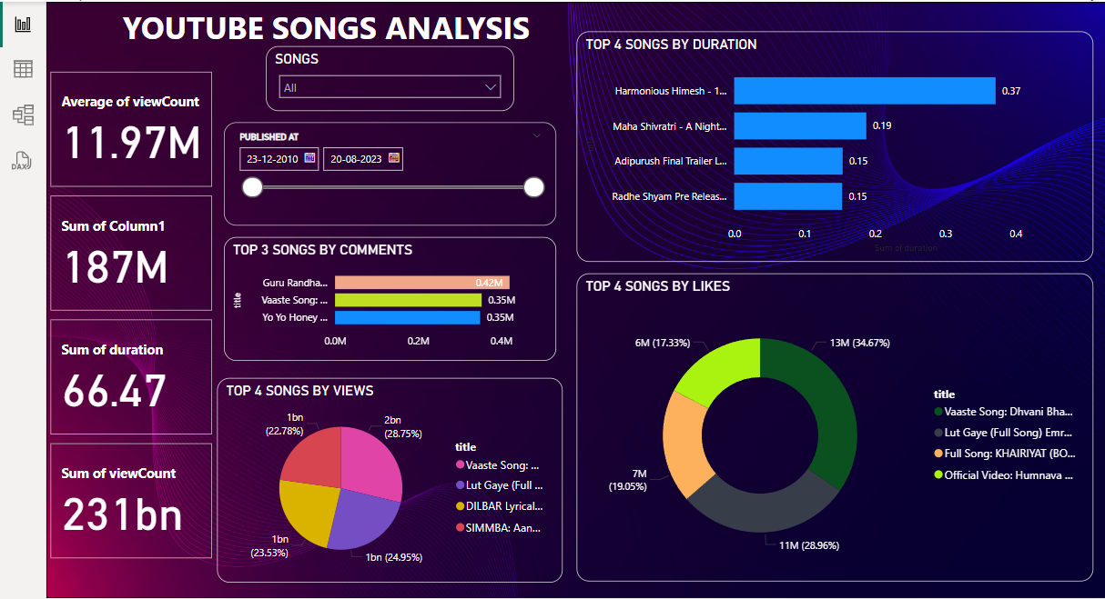
Dashboard

Slide 7
Insights
Popular Channels and Content Types: Identify which YouTube channels attract the most views and engagement for music videos. Determine which types of content (e.g., genres, formats) resonate most with viewers based on metrics like views, likes, and comments.
Impact of Tags and Descriptions: Analyze the effectiveness of tags and descriptions in influencing video visibility and viewer engagement. Identify popular keywords and phrases that correlate with higher view counts and engagement metrics.
Temporal Trends and Peak Times: Discover trends in video performance over time, including seasonal variations and recurring patterns. Determine optimal times and days for publishing new videos to maximize views and engagement.
Viewer Engagement Patterns: Explore relationships between metrics such as likes, comments, and views to understand what drives viewer interaction. Identify factors that contribute most significantly to increasing viewer engagement with music videos.
Performance by Video Duration and Quality: Assess how video duration (duration) and quality (definition) impact viewer retention and engagement. Determine optimal video length and quality settings to optimize viewer experience and engagement.
Geographical and Demographic Insights: Gain insights into viewer demographics (age, location) and regional preferences for specific music genres or artists. Tailor content strategies and promotional efforts based on geographical insights to reach target audiences effectively.

Slide 8
Conclusion
This project is all about using Power BI to uncover insights that can help musicians, channels, and anyone interested in YouTube music videos. By analyzing data smartly, we aim to help creators reach more viewers and enhance their video performance.
By leveraging Power BI for detailed analysis, this project aims to empower YouTube creators with the knowledge and tools needed to maximize the impact of their music videos. It provides actionable insights that can help creators grow their audience, improve engagement metrics, and ultimately achieve their content goals more effectively.

Slide 9
Thank You

